Slide 1
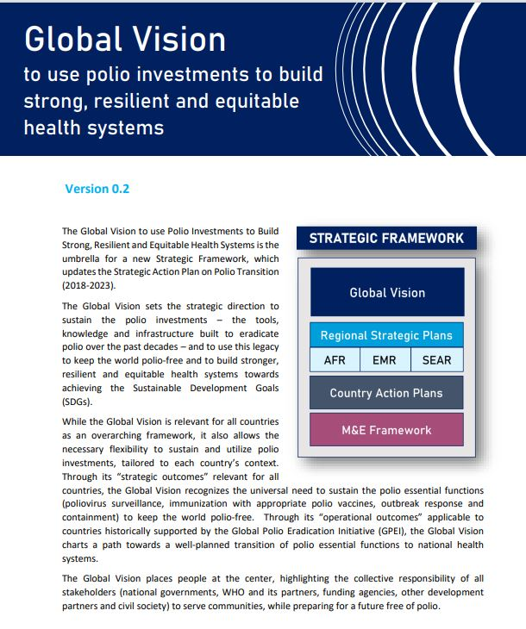
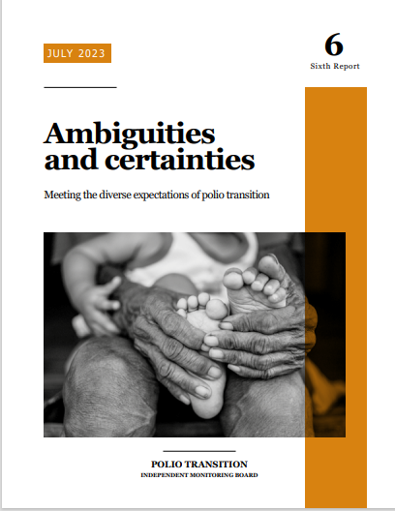
PPG update:
Post-2023 strategic direction for polio transition and post-certification

Slide 2
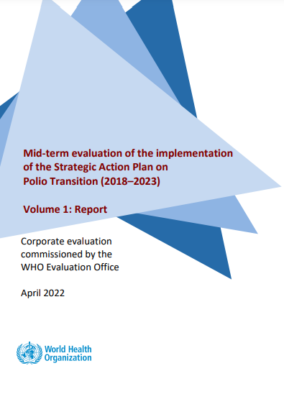
Post-2023 strategic direction responds to the recommendations of two independent evaluations
Mid-term evaluation of the implementation of the Strategic Action Plan on Polio Transition (2018–2023)
6th Transition Independent Monitoring Board Report: Ambiguities and Certainties
Evaluated progress of the implementation of SAP (2018 – 2023).
Published in April 2022, captures 100+ stakeholder interviews, country surveys/deep-dives held over Nov. 2021 – Apr. 2022.
10 recommendations focused on governance & coordination; programmatic integration; strategic planning & financing; monitoring & evaluation.
Independent monitoring of polio transition since 2017.
6th report published in July 2023 captures the deliberations of the April TIMB meeting, and insights from country/donor interviews held over Nov. 2022 – Apr. 2023.
10 recommendations focused on the need to clarify accountability through and beyond GPEI sunset.
Report: https://www.who.int/publications/m/item/mid-term-evaluation-of-the-implementation-of-the-strategic-action-plan-on-polio-transition-(2018-2023)
WHO Management Response: https://www.who.int/publications/m/item/mid-term-evaluation-of-the-implementation-of-the-strategic-action-plan-on-polio-transition-(2018-2023)--management-response---september-2022
Report: https://polioeradication.org/wp-content/uploads/2023/08/6th-TIMB-report-Ambiguities-and-certainties-20230731.pdf

Slide 3
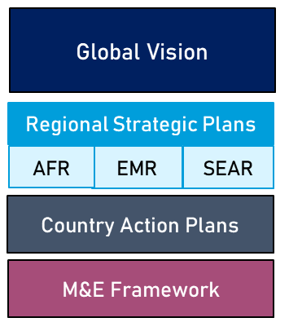
Post-2023 Strategic Framework for Polio Transition
Sets the overall strategic direction (link below, to be presented to the EB) ​
Acknowledges lessons-learned, changing context
Theory of Change (3 impact goals, 4 strategic & 4 operational outcomes)​
Themes tailored to regional context (drafts by end-2023)
SEARO: Increasing immunization coverage / reaching zero dose children.
EMRO: Integrated delivery in fragile settings.
AFRO: Stopping and preventing outbreaks, building resilience.
Differentiated approach
SEARO / EMRO: Stand-alone plans, to be reviewed regularly
AFRO: Integration into existing plans / frameworks
Measuring both performance and progress (draft by end-2023)
Outcomes sustaining the polio essential functions
Milestones to monitor the transition process.
Global Vision to use polio investments to build strong, resilient and equitable health systems, V2: https://www.who.int/publications/m/item/global-vision--to-use-polio-investments-to-build--strong--resilient-and-equitable--health-systems

Slide 4
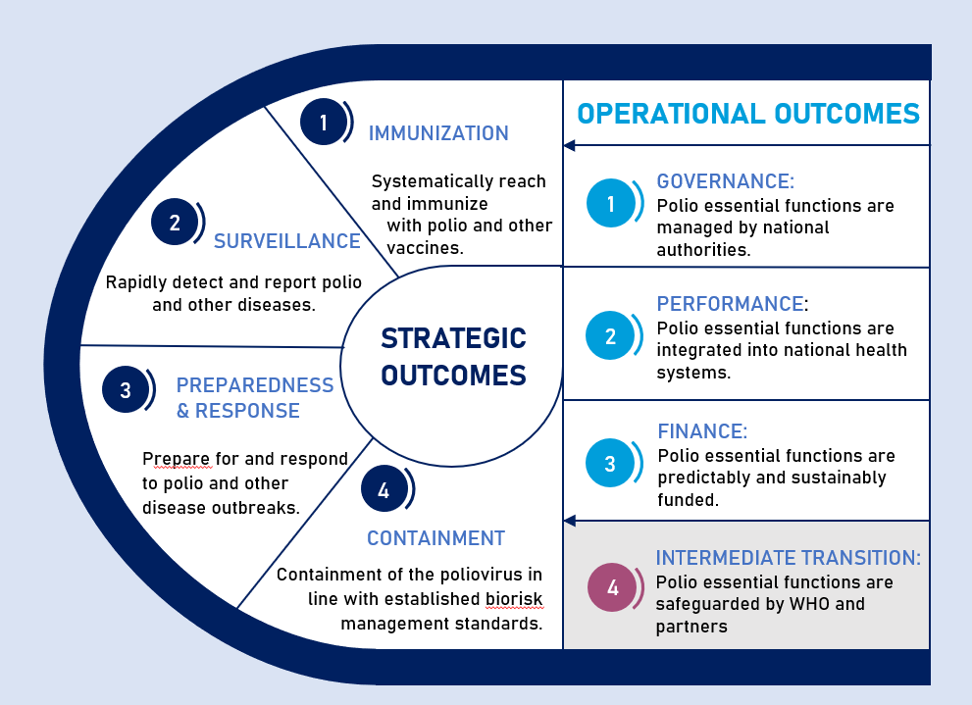
Post-2023 Strategic Framework:
Vision, Strategic and Operational Outcomes
A world in which polio investments are sustained and used to build strong, resilient and equitable health systems, where all countries:
Remain polio-free
Minimize the burden and eliminate VPDs
Rapidly detect and control disease outbreaks

Slide 5
6th TIMB Report:
Accountability after GPEI sunsets
Unlike eradication, polio transition has lacked global management, day-to-day-leadership and a binding partnership to drive it forward.
Due to the deteriorating operating environment in countries, transfer of responsibility to governments has been more difficult to achieve.
Polio transition is running alongside eradication, rather than following it, as was originally envisioned.
There has been little substantive expansion in the number and range of non-polio partners.
Little progress has been made on assessing medium and long-term funding needs.

Slide 6
TIMB Recommendations
Re-branding of transition to make polio/non-polio outcomes clearer
New multi-partnership organisation responsible for coordination and oversight (5-year life span, include donors, led by a management team in WHO/POL)
Formal WHO workforce plan, with a centrally coordinated approach to workforce management
POB decision to transfer cVDPV outbreak response responsibility to WHE in 2024
Meet and sustain data management and analytics capacity
Monitoring and accountability framework
Comprehensive mapping of resources
Assessment of whether IA2030 goals and functions will be able to deliver on polio outcomes without additional financial support
High level discussion with countries not complying with GAP III
Roadmap to align containment with eradication timelines

Slide 7
Draft Accountability through GPEI sunset and beyond
Interruption of Transmission
2023-25
Certification
Up to 2026-28
GPEI Sunset
Post- Certification
2027/28+
Goals
Interrupt WPV and cVDPV transmission
WPV and cVDPVs certified as eradicated
Maintain a polio-free world
Programme accountability
Immunization: IPV/Hexa
(under IA2030/Gavi 5.0)
GPEI: Surv., SIAs (bOPV, nOPV), Containment
Health Emergencies: IHR /PHEIC
Immunization: IPV/ Hexa, OPV withdrawal (under IA2030/Gavi)
Health Emergencies:
Surveillance (balance btw AFP/ES to evolve) + OBR with nOPV + Containment + IHR Review Committee
Immunization: IPV/Hexa
(under IA2030/Gavi 6.0)
GPEI: Surv., SIAs (bOPV/nOPV) + Containment, with transition to
Health Emergencies: IHR (PHEIC/Review Committee)
Funding
GPEI continues to fund endemic and non-endemic high-risk countries
WHO’s non-GPEI funding needs for PB2024/25 are approx. US$65Million
GPEI funding ends upon GPEI sunset.
WHO provides support through GPW14
WHO support scales down as programmatic requirements decrease and/or countries assume responsibility

